Slide 1
Integrating Big Data Analytics & Artificial Intelligence in Accounting Programmes: An Implementation Case Study
Terry Harris & Amir Michael
Durham University Business School
Durham University, UK

Slide 2
Introduction
Big Data is characterised by three attributes: Velocity, Variety and Volume (Laney, 2001) in addition to Veracity and Volume (5Vs)
Big Data results from two trends: plummeting cost of storage, and innovative means to analyze and interpret data.
Changes needed to accounting education to better prepare students to effectively utilize Big Data are just beginning to emerge.
Not only are Big Data skills such as database analyses, visualisation creation, and tool selection required, graduates are increasingly expected to be able to apply higher order thinking skills to related analyses. Shah et al. (2012) called these Big Data higher order skills Big Judgment.

Slide 3
Big Data Education
The presence of Big Data will likely require more significant changes than ever before, as we can expect an increase in both analytical skills and database skills being added to accounting curriculum.
Yoon, Hoogduin, and Zhang (2015) suggest that there will not be enough trained accounting analysts to audit all the available data.
Given the emphasis on data analytics, we suggest accounting education should train students to ask good questions.
This training of higher order thinking skills is consistent with a number of recent directives by accounting education agencies such as the Accounting Education Task Force, the Pathways Commission, and the Association for the Advancement of Collegiate Schools of Business (AACSB).

Slide 4
Asking Good Questions
The task force calls for accounting education to better prepare students for long-term career demands and reduce emphasis on first job skills.
Accounting education objectives should reflect how accountants add organisational value.
We believe the ability to ask good questions is a long-term career skill particularly useful to organisational value.
The Pathways Commission calls for graduates to comprehend emerging Information Systems (IS) technologies and to be able to employ quantitative methods and draw appropriate insights from an analysis.

Slide 5
Asking Good Questions (Cont’d)
The ability to ask good questions helps students qualify the insights generated by Big Data analyses.
A recent AACSB accounting accreditation change (Standard A7) calls for more learning experiences with IS in accounting.
Critical thinking has a number of definitions, most of which share common elements such as the ability to work on unstructured and unfamiliar problems, the acquisition and evaluation of information and knowledge (McPherson, 1996), the ability to apply rationality and logical thinking to organizational problems, and to examine unstated assumptions (Kimmel, 1995; Kurfiss, 1988; Scriven & Paul, 1987).

Slide 6
Critical Thinking & Big Data
While critical thinking in general would improve Big Data analyses, here we focus on one aspect of critical thinking—asking good questions.
While our call for training in the area of questioning skills in the Big Data arena is, as far as we know, the first in accounting, Boyd and Crawford (2011) in the social science domain also call for critically interrogating the assumptions and biases behind Big Data.
However, most of their insights are directed at social science issues such as privacy and inequality and do not address aspects of business analyses.
Our goal is to help future accountants become informed skeptics and recognize the opportunity and value of asking ‘‘good” questions in this Big Data era.

Slide 7
Case Study Background
2018/2019 Survey of Durham University Accounting Students
BSc. Accounting and Finance
How important would you consider Data Analytics to be for the future of Audit? 3.89
My course offers great discussion/ learning opportunities in Data Analytics. 2.15
BSc. Accounting (KPMG programme)
Do you see your role as an Auditor changing given recent developments in Data Analytics? 4.35
My course offers great discussion/ learning opportunities in Data Analytics. 2.09

Slide 8
Feedback Response
Durham University
New (introduced in 2019/2020) Final Year Module: Big Data Analytics for Accounting and Auditing
    Amir Michael MBA., PhD.
    Terry Harris MPhil., PhD.
Masters in Business Analytics in Durham university Business School
Partnership in with Rutgers University’s Continuous Auditing & Reporting Lab (Durham Rutgers Accounting Analytics Network DRAAN)

Slide 9
Big Data Analytics Module Structure
Big Data Analytics for Accounting and Auditing
Term 1 Lecturer
  Amir Michael MBA., PhD.
Teaching Week | Lecture Topic
1 | Introduction: Understanding Big Data
2 | Big Data Utilisation & Adoption
3 | Descriptive Data Analytics
4 | Diagnostic Data Analytics
5 | Predictive Data Analytics
6 | Prescriptive Data Analytics
7 | Artificial Intelligence, concepts and applications
8 | Data Visualisation & Heat Maps
9 | Data Storage, Security & Ethical Considerations
10 | Review

Slide 10
Big Data Analytics Module Structure
Big Data Analytics for Accounting and Auditing
Term 2 Lecturer
  Terry Harris MPhil., PhD.
Teaching Week | Lecture Topic
1 | Machine learning for Big Data Analytics: Introduction to Linear Regression
2 | Linear Algebra and Linear Regression with Multiple Variables
3 | Logistic Regression with Regularisation
4 | Introduction to Artificial Neural Networks (ANNs)
5 | More Artificial Neural Networks (ANNs)
6 | Support Vector Machines (SVMs)
7 | Association Rules and Clustering with K-Means
8 | Dimensionality Reduction using PCA 1
9 | Dimensionality Reduction using PCA 2
10 | Review

Slide 11
Acquired Skills
Data analytic skills in Stata, Python, & Matlab.
Data visualisation and presentation skills in Tableau.

Slide 12
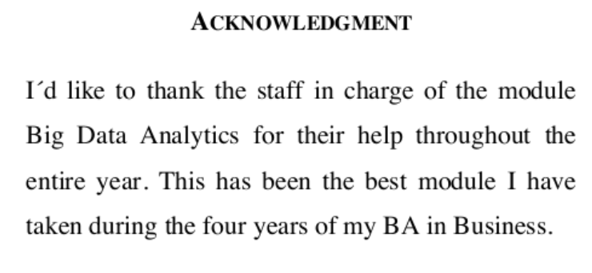
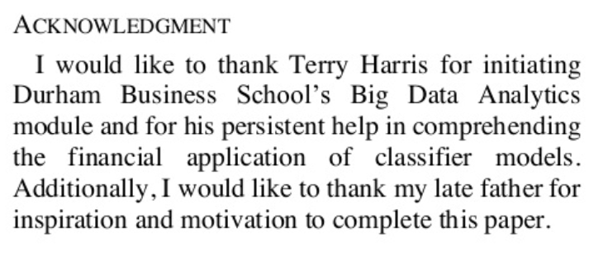
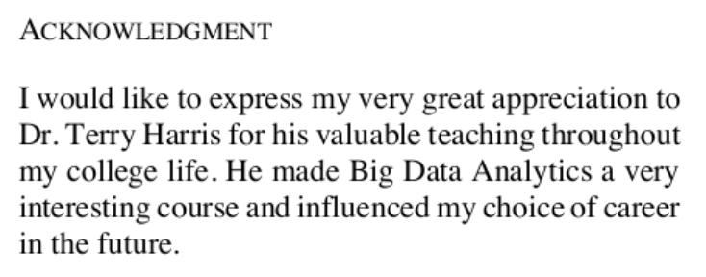
Students’ Feedback
I have to say in first term Amir Micheal as a lecturer has honestly been fantastic and really helpful. He responds straight away to any queries and really tries to help you to understand certain things. So I feel like if I had a different lecturer I wouldn't have understood certain things if it wasn't for Amir. Great teaching style!
Best part of the module thus far has been the practical applications included in lectures as well as summative assignments. It gives a good introduction what data analytics can be used for in real life problems.
I foresee this module to be of much greater use beyond university compared to many other modules
The module is interesting, interactive and very useful in terms of application in the real world.

Slide 13
Conclusion
Auditors, accountants and accounting educators are reluctant to use big data analytics techniques that are perceived as being too far ahead of those adopted by their clients and the wider practice.
We outline possible application areas for Big Data Analytics in auditing/ accounting.
Finally, we point-out what we are doing to advance accounting education in this area.

Slide 14
Many Thanks
Questions?
Terry Harris
Amir Michael
terry.harris@durham.ac.uk
a.e.iskander@durham.ac.uk

